Slide 1
PARES - Case study: Italy - The experience of Employment Services
DANIELE LUNETTA
Roma, 13/05/2016

Slide 2
MULTILEVEL GOVERNANCE
Italian PES and the Youth Guarantee
National co-ordination
Operational management
Local implementation
PES
MLPS
Regions
Private providers
NEETS: new «client population» that was not previously reached by PES
Centralized offering of ALMPs based on the collaboration between PES and private agencies
Tracking and monitoring of entire life-cycle of the ALMPs: case management, orientation, tutoring, implementation and follow-up
New procedures: profiling according to distance from the labour market; ad hoc accreditation systems in the Regions
Compensation: Regions with high outflows of NEETs will have to compensate Regions experiencing inflows
PARES - BENCHMARKING EMPLOYMENT SERVICES’ CONTRIBUTION TO THE IMPLEMENTATION OF THE YOUTH GUARANTEE

Slide 3
INSTITUTIONAL TRANSITION
Short and long-term
Short Term
«Jobs Act» decree n. 150, 2015:
Development of a national agency for the management of ALMPs (ANPAL), tasked with the development of a centralised IT system
Shift in responsibilities for the management of PES (local government reform)
Restructuring of services to provide an integrated offering (one-stop-shops for orientation, profiling, matching, support for start-ups)
Partnership and active involvement with private providers based on standard unit costs
Long Term
Constitutional Reform: overhaul of multi-level governance in Italy
Art. 31: The national government will become exclusively responsible for welfare policies, health and safety regulations, ALMPs and vocational training
Key role played by ANPAL, under the supervision of the Labour Ministry
PARES - BENCHMARKING EMPLOYMENT SERVICES’ CONTRIBUTION TO THE IMPLEMENTATION OF THE YOUTH GUARANTEE

Slide 4
Regional Models
3 DIFFERENT REGIONAL MODELS
10 REGIONS, both the take up and the management of the active policy measures is almost completely in charge of the PES
7 REGIONS (Abruzzo, Basilicata, Friuli Venezia Giulia, Lazio, Puglia, Liguria and Veneto), private employment services or other accredited operators have an important role in starting the young NEET to active policies and in managing the measures
3 REGIONS (Lombardia, Piemonte and Campania), the private operators play an important role since the take up of the young people
PARES - BENCHMARKING EMPLOYMENT SERVICES’ CONTRIBUTION TO THE IMPLEMENTATION OF THE YOUTH GUARANTEE

Slide 5
Monitoring and IT Platform
GOAL
CREATION OF A UNIQUE VIRTUAL AREA
Creation of a technology platform at the base of a unitary nationwide system with a coordinating role between the different actors interested in exchanging information and services
PLATFORM FOR MANAGING THE YOUTH GUARANTEE
Integrated system between the:
Portal for the youth guarantee (www.garanziagiovani.gov.it)
Web portal cliclavoro (www.cliclavoro.gov.it)
The data entered in the platform and in the database PAPL integrate the information of provincial services and employment agencies
Interoperability with other databases
Traceability of registrations
Creation of the SAP
Monitoring
FUNCTIONALITY
ENSURING «IT TRACING» FROM THE REGISTRATION TO THE PROGRAMME TO THE END OF THE ACTIVE POLICY DELIVERY
PARES - BENCHMARKING EMPLOYMENT SERVICES’ CONTRIBUTION TO THE IMPLEMENTATION OF THE YOUTH GUARANTEE

Slide 6
Key projects managed directly by the Ministry of Labour and social policies
CRESCERE IN DIGITALE
The Project “Crescere in Digitale” is implemented by the Ministry of Labour and Social Policies and Unioncamere in partnership with Google, and is aimed at the creation of "young digitizers", able to spread digital skills among entrepreneurs.
It involves the construction of a training and job placement path, involving the following steps:
Training to be delivered in e-learning;
Specialist training "in presence" aimed at job placement in the companies hosting the internships or targeted to support self-employment and self-entrepreneurship;
6 months’ internships in companies.
CRESCERE IMPRENDITORI
Crescere Imprenditori is a project implemented by Unioncamere, throughout the Italian territory. After a self-assessment test on self-entrepreneurial attitudes, young NEET registered to the Youth Guarantee can access a 60 hours group course (also via live streaming) and 20 hours of specialist coaching and customized technical assistance. The project represents an opportunity to develop business ideas and entrepreneurial initiatives, through the drafting of a business plan.
SELFIEmployment
To provide support to access to credit, the Ministry has implemented, with the support of Invitalia, the financial instrument SELFIEmployment: a revolving fund for over 120 Million to give credit to deserving business ventures.
Initial recipients are young NEET aged between 18 and 29 years old, registered to the Youth Guarantee and who have successfully completed the coaching and support paths for the start-up of a new business.
The SELFIEmployment Fund finances investment plans between 5000 and 50000 euros.
PARES - BENCHMARKING EMPLOYMENT SERVICES’ CONTRIBUTION TO THE IMPLEMENTATION OF THE YOUTH GUARANTEE

Slide 7
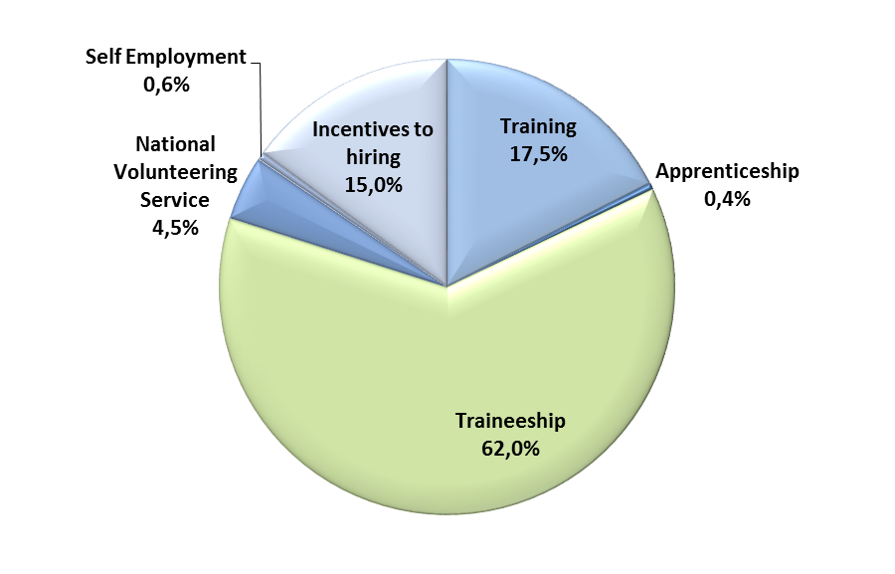
Main outcomes
Registration, Taken in Charge and Active Policies in YG
Type of active policy offered
Data – 5th May 2016
PARES - BENCHMARKING EMPLOYMENT SERVICES’ CONTRIBUTION TO THE IMPLEMENTATION OF THE YOUTH GUARANTEE

